Slide 1


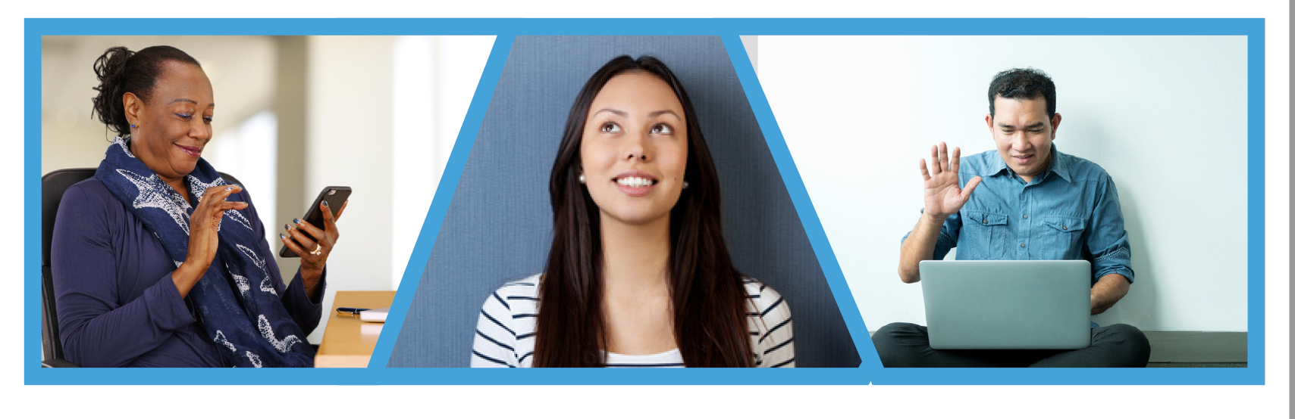
Add your logo here
Welcome!
Thank you to our participants and guests for taking the time to learn from one another.

Slide 2

Add your logo here
CAREER CHATS
60-Minute Zoom conversations to gain insight, industry knowledge and tips to finding a successful career

Slide 3
Before We Start!
Add your logo here
Friendly Reminders:
Career Chats is a professional environment
Please stay muted during conversation in main room
Please communicate via chat box or raise your hand an unmute yourself.
We encourage participants to turn video on if you are comfortable to and in an environment where it is appropriate to do so

Slide 4

Before We Start!
Add your logo here
YouthWorks Weekly Raffle!
Active participation
Video camera on
Ask questions/ via chat or unmute
MUST provide contact info to be entered into drawing (First name, last name, D.O.B, region and program, phone number and email address)
* This slide is optional

Slide 5
Before We Start!
Add your logo here
Agenda:
Welcome & Opening Activity
Panel Introductions
Group Discussion
Wrap-up: Takeaways and Next Steps

Slide 6

Ad Add your logo here

Slide 7
Before We Start!
Add your logo here
Industries:
Workforce Development
Education and Family Support
Court System

Slide 8
Before We Start!
Add your logo here
Workforce Development
Meet Your Career Chat Professional!
Name: Tonja Mettlach
Title: Executive Director
Company: Mass Workforce Association

Slide 9
Before We Start!
Add your logo here
Education/ Family Support
Meet Your Career Chat Professional!
Name: Yemi Ajao
Title: Interim Director, Community Resource Development
Company: Framingham Public Schools

Slide 10
Before We Start!
Add your logo here
Court System
Meet Your Career Chat Professional!
Name: Judith Stein
Title: Probation Officer
Company: Commonwealth of Massachusetts

Slide 11

Before We Start!
Add your logo here
Group Discussion

Slide 12
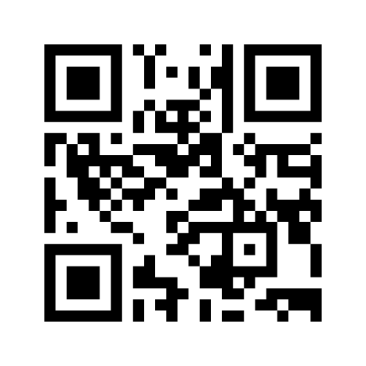
Before We Start!
Add your logo here
Go to www.menti.com and use the code: 4998 7589
What is a skill set that you would like to develop after today’s career chat?

Slide 13
Before We Start!
Add your logo here
Thanks to all our professional guests and for your interest and participation!

Slide 14
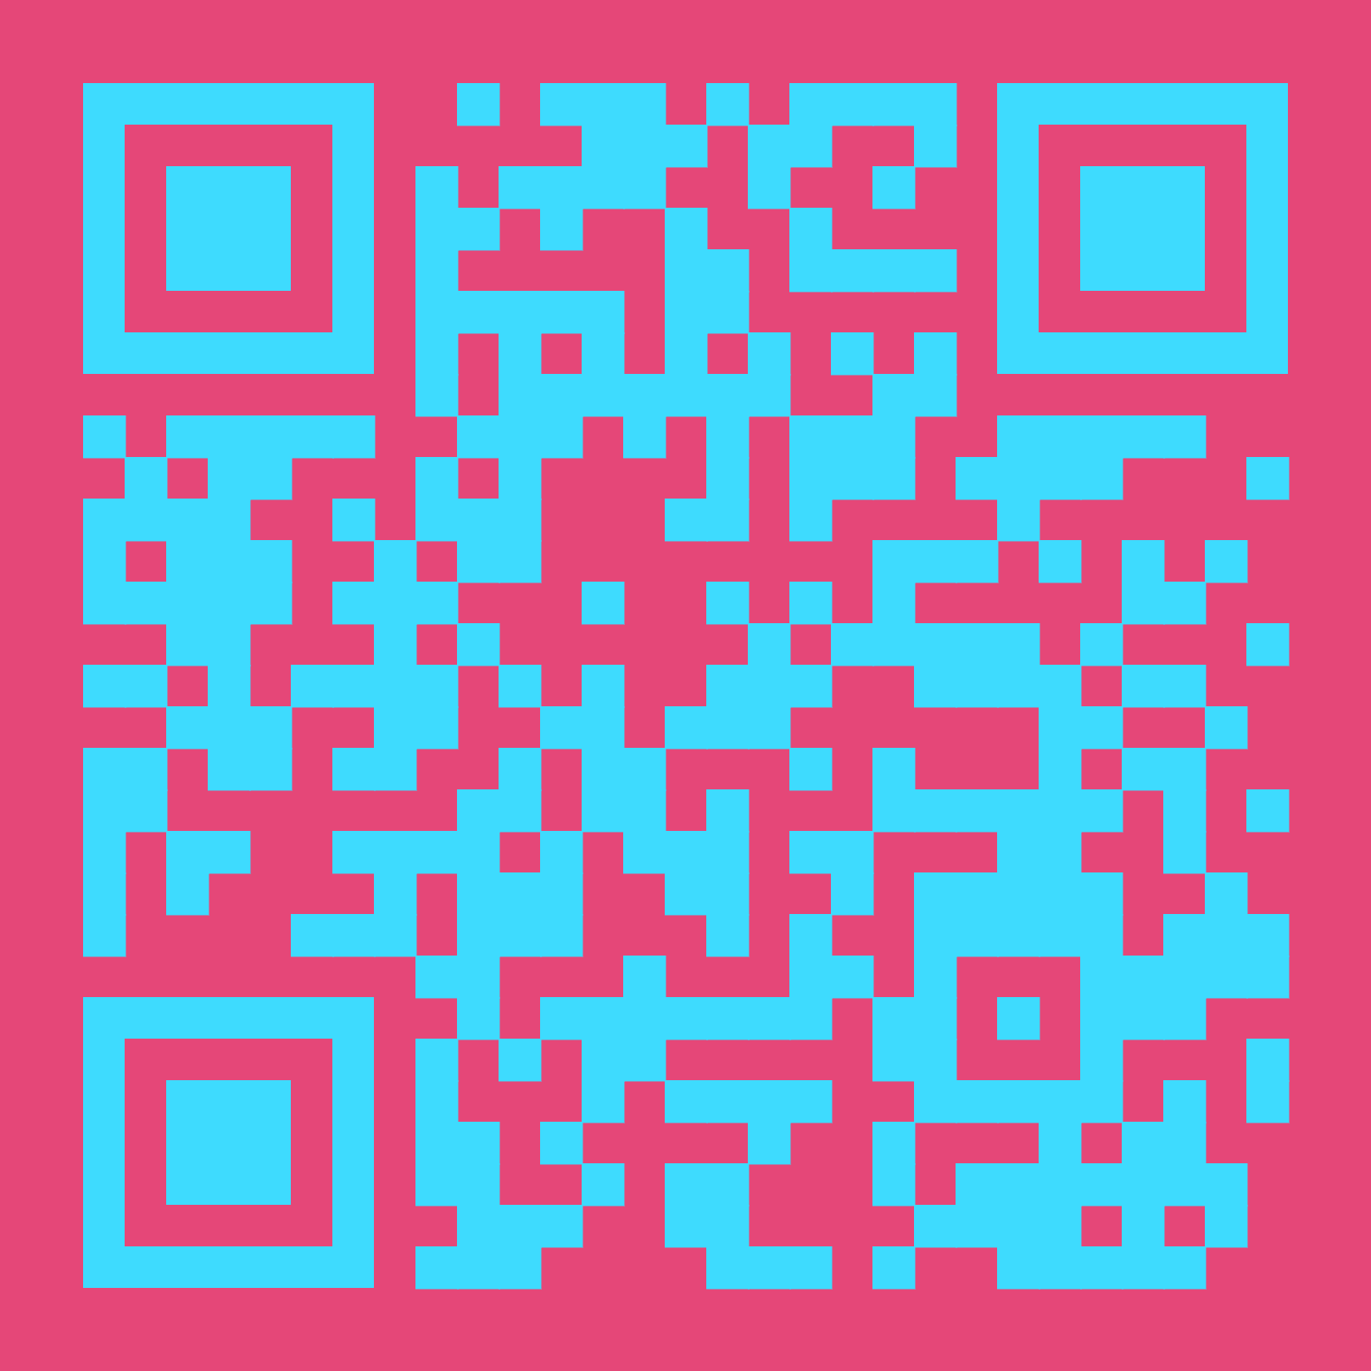
Before We Start!
Add your logo here
Join Our LinkedIn Group!
MA YouthWorks Network
https://www.linkedin.com/groups/12447490/

Slide 15
Before We Start!
Add your logo here
Host Contact Information
Name:
Title:
Email:
Telephone:

