Slide 1


Welcome to the YouthWorks Hub

Slide 2
Objectives
By the end of this session you will:
Gain an understanding of the YouthWorks Hub and requirements
Know how to access the YouthWorks Hub
Understand the structure of the YouthWorks Hub
Feel knowledgeable accessing and tracking participant information in the YouthWorks Hub
Know how where to go for support when working in the YouthWorks Hub

Slide 3

YouthWorks Hub
YouthWorks Hub = Salesforce

Slide 4

YouthWorks Hub
1
What
The YouthWorks Hub is a central place to collect, store and report on YouthWorks participant information.
2
Why
Who
3

Slide 5
YouthWorks Hub
1
What
The YouthWorks Hub was created to have an easy, effective and safe way of entering and storing participant data.
The goal is for regions as well as YouthWorks to be able to access, track and communicate data accurately and easily.
2
Why
Who
3

Slide 6
YouthWorks Hub
1
What
This platform will be used by all grantees.
Participants will not have access to this platform.
2
Why
Who
3

Slide 7
Accessing the YouthWorks Hub
When filling out the RFP, Regions will approve partners, that partner information will be entered into the YouthWorks Hub by Regional Support staff
If a new staff is onboarded after the RFP information is submitted
  Region Leads can add them to the Hub when staff are onboarded
  Region leads will add a new contact and that person will get an onboarding email once they are approved by YouthWorks staff
  Onboarding emails will come from youthworks@commcorp.org
If a staff leaves during an RFP cycle
    Region leads should let their Regional Support Manager know so we can deactivate their account

Slide 8
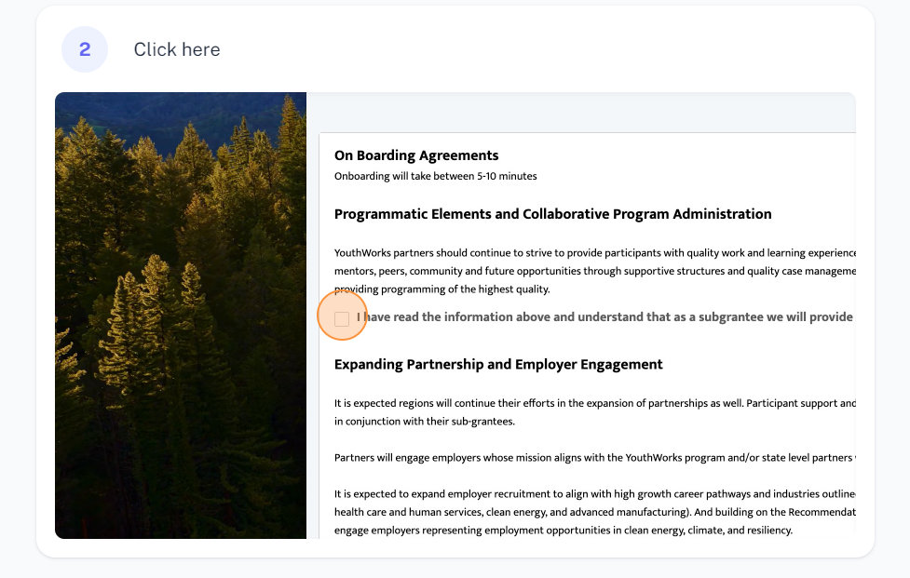
Staff Agreement
A contract between the YouthWorks team and the new user to ensure all the guidelines and expectations are clear.
Each staff will have to agree to this when they first sign into the YouthWorks Hub
The goal is to remind regions on what needs to be completed to ensure they are compliant with the grant. A synopsis of what is in the RFP.
If YouthWorks staff believe a region or site is out of compliance they will turn the agreement back on so staff can review it

Slide 9

YouthWorks Hub Structure

Slide 10
Entering Participant Data
Application Upload
Mass Upload
Individual Entries
Using the YouthWorks application, participants will fill out all the information and that information will be directly uploaded into the YouthWorks Hub
YouthWorks will provide a template via a SharePoint link for regions to enter youth data
Regions will be expected to upload their completed spreadsheets to their secure SharePoint link
Regional Support staff will ensure data is uploaded within 3 business days of it being uploaded to SharePoint
Participant information can be manually entered individually via List of Youth Applications Tab in the YouthWorks Hub
This is a great option for smaller regions or for participants that join the program post Mass Upload

Slide 11
Sections of the YouthWorks Hub
List of Youth Applications
All participant applications that are submitted
List of Youth Profiles
All accepted youth’s information
List of Youth Participations
Current and past participant Cycle specific information
List of Worksite Assignments
Current participant worksite assignments
List of Worksite Organizations
All worksites and positions participants will be placed at

Slide 12
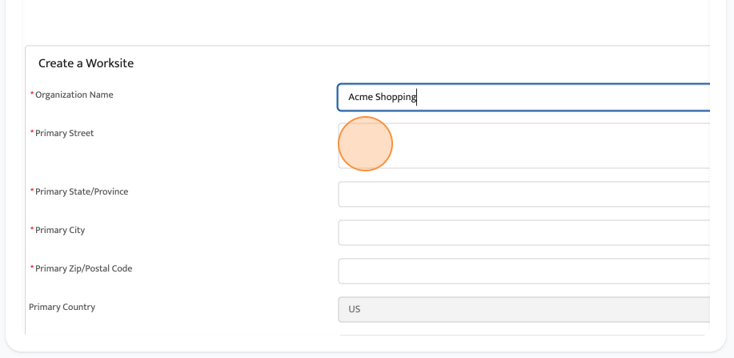
Worksite Organizations
All Worksites that participants will be placed at need to be entered into the YouthWorks Hub
Start by clicking the Create Worksite tab
Enter all of the worksite’s information and hit save
This creates a new worksite organization that participants will later be linked to
Click into the created Worksite and add any jobs that participants will have when placed here
Each worksite you create will serve as a landing page for all future worksite agreements
The goal is to create a Worksite once and continuously add jobs/worksite assignments

Slide 13
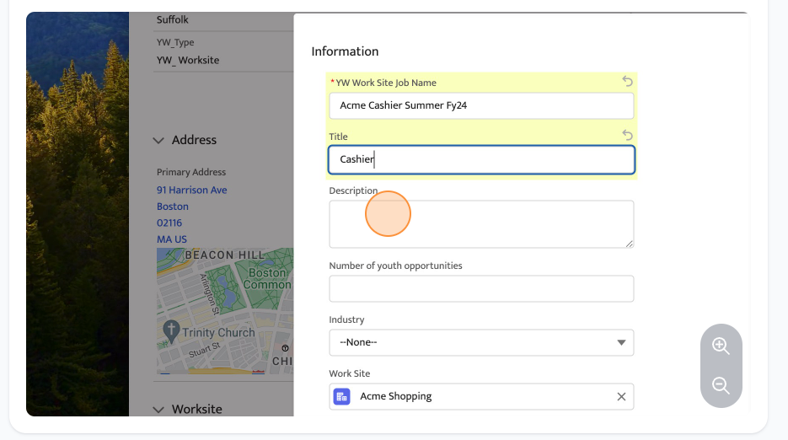
Worksite Jobs
All Worksites will have specific jobs associated with them that participants can be placed into.
Start by clicking the Worksite you want to add a job to
Scroll down to the bottom, tab over to Worksite Jobs
Click New on the right hand side
Enter all of the information about the job
Hit Save
Repeat until all jobs that will be offered from this Worksite are added

Slide 14
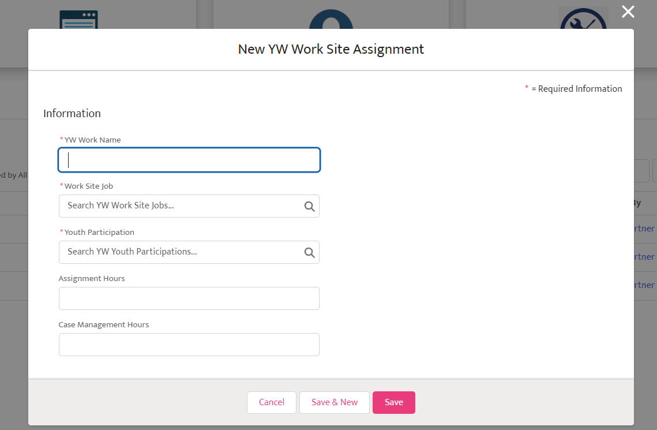
Worksite Assignments
Worksite Assignments are the participant’s Worksite placements
Option 1
Click the Youth Participation
Under YW Worksite Assignments click add new
Enter the Worksite assignment information and hit save
Option 2
Click List of Worksite Assignments
Click add new
Enter Worksite information, including connecting the Worksite and the Participant assigned
Hit save

Slide 15
Worksite Assignments
Clearly organizes the Worksite, the Worksite Job and the Participant that is assigned to that job
Worksite Assignment Details, staff can track
  Assignment Hours
  Case Management hours
Worksite Assignment Related, staff can track
  Notes and Attachments (Case management notes, )
  Performance Reviews

Slide 16
Flow of Worksite Information
Worksite Organizations
Worksite Jobs
Worksite Assignments
Acme Shopping has agreed to be a YouthWorks Partner in hosting participants at their store.
Acme Shopping has the following positions available
Cashier: 2
Stocker: 1
Customer Service: 1
The below participants will be assigned to each of the jobs at Acme Shopping
Cashier: Ari Lennox
Cashier: Jasmine Sullivan
Stocker: Lauryn Hill
Customer Service: Summer Walker

Slide 17
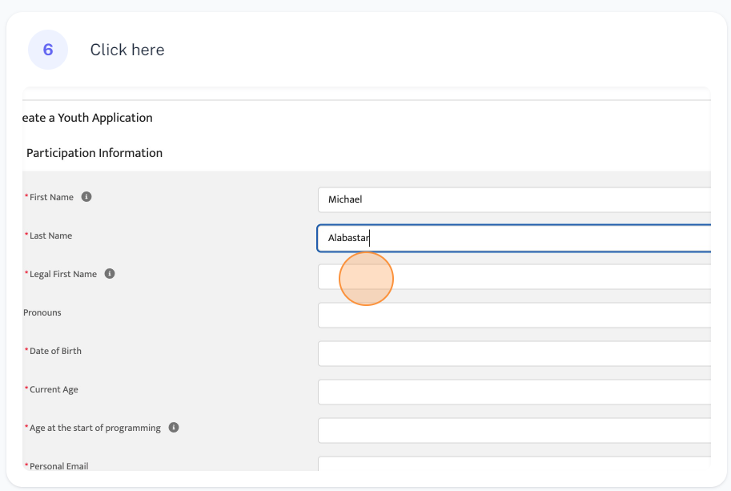
Youth Applications
Youth Applications is where all potential participant applications will be housed
Click Create a Youth Application
Fill out the participant’s information
Ensure that the Status of the participant’s application is correct
  New Application
  In Review
  Accepted to the Program
  Do Not Recommend
Hit save

Slide 18
Youth Applications
Applications will appear under the Youth Application’s tab no matter how they are uploaded
Applications will serve as historical data if participants are not accepted into the program
Youth Applications can be edited by clicking the YW Youth Application Name or the pencil button
Once a Youth Application is accepted, a Youth Profile is created

Slide 19
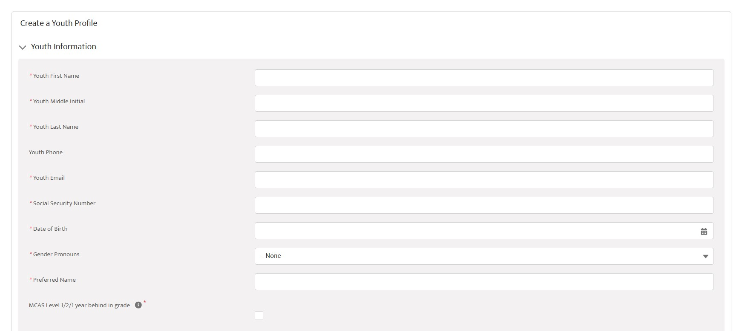
Youth Profiles
Youth Profiles are where all accepted applications will populate
In Youth Applications, change the participant application status to accepted
Click List of Youth Profiles tab
Click the name of the participant under YW Youth Profile Name
Click Edit and input additional participant information as well as check to ensure all information is correct

Slide 20
Youth Profiles
Managing the Youth Profile: Case managers should review the profile with the youth themselves to ensure all the information is accurate
If a youth is already accepted into the program, you can enter their information directly into the Youth Profile
All YW Youth Profile names will be categorized by the Participant’s first and last name as well as the month and year it was created
  i.e Ari-Lennox 05/2024
The Youth Profile is also where staff can see participant’s past participations under related contacts
Once entered, this information can be referenced but it won't be accessed day to day
  Tracking the activity through out the program will be done in the youth participation

Slide 21
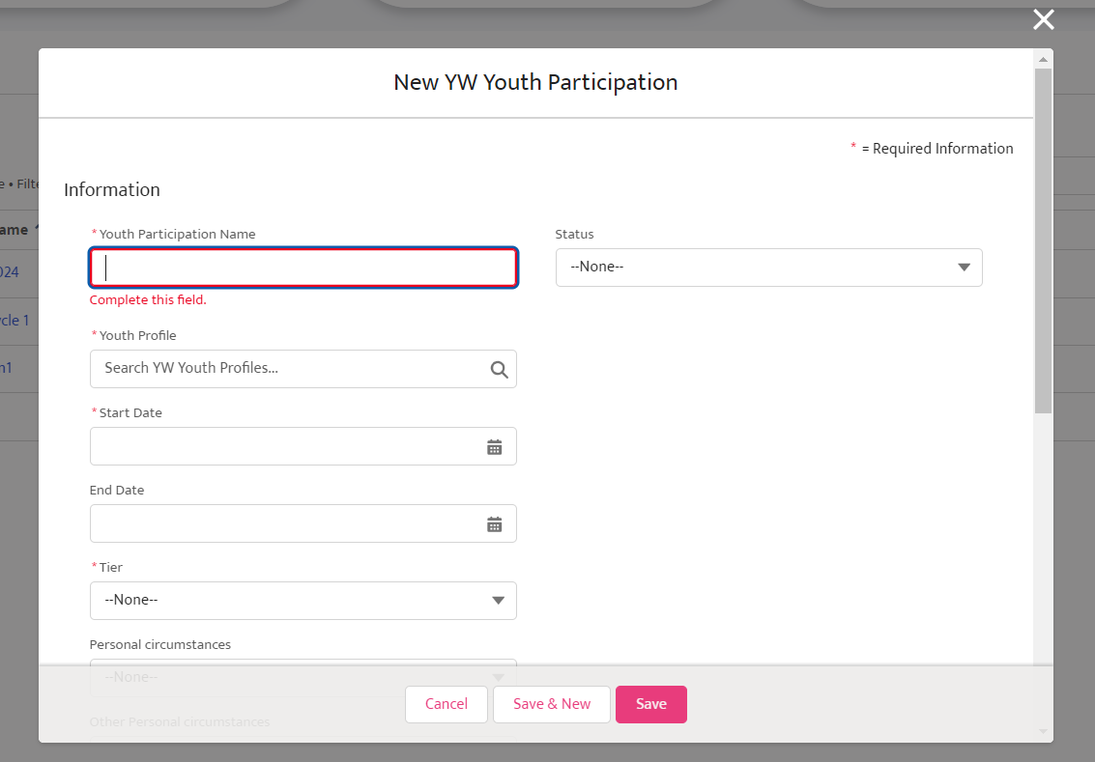
Youth Participations
Youth Participations is the participant information for their current program cycle. There must be a Youth Profile for a Youth Participation to be created
Click the List of Youth Participation tab
Click new and enter the participant information, ensuring to connect their youth profile
Once all the information is entered, hit Save

Slide 22
Youth Participations
All participants activities will be tracked here, these activities include;
Participants hours
Worksite Assignments
Performance Reviews
Tier and Cycle
Case Management Hours
Youth Participant Name will be categorized by
  Participant’s last name
  Participant’s Tier
  Participant’s Program Start Date
  i.e Lennox Tier 111 07/01/2024
Each Participation is linked to the Participant’s Youth Profile

Slide 23
Flow of Participant Information
Youth Applications
Youth Profiles
Youth Participations
Jasmine Sullivan has applied to the Cyle 1 2024 YouthWorks program and filled out her information
Case Manager Mark Green has reviewed Jasmine’s application and decided she would be a good fit. He marks the application accepted.
Mark then meets with Jasmine to review her Youth Profile with her, ensuring all details are correct
Mark and Jasmine discuss that she would be a great fit as a cashier at Acme Shopping.
Mark creates a Youth Participation to track Jasmine’s participation in Cyle 1 of the 2024 YouthWorks program as a Acme cashier.

Slide 24
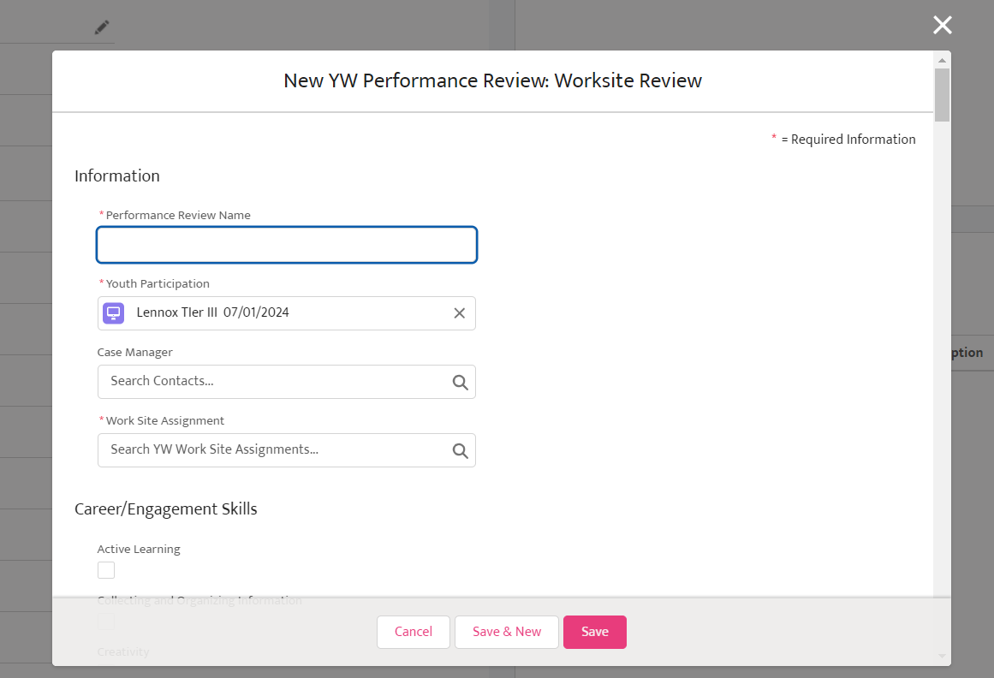
Performance Reviews
Performance Reviews are a way to track meaningful progress during a participant’s work experience
Click List of Youth Participations
Click the participant’s name
Click New under Performance Reviews
Fill out the performance review of the participant
Ensure that the performance review is reviewed with the participant and signed by the staff and participant

Slide 25
Performance Reviews
Staff should aim to give each participant a performance review at least once during each YouthWorks cycle
Staff can evaluate the youth by
  New skills they have learned
  Attendance and punctuality
  Improvements in soft skills
  Any region-specific additional goals or milestones
Staff can write comments during the review to record the conversation
Staff should refer back to previous performance reviews to encourage and acknowledge growth in participants

Slide 26
Worksite Orgs
Youth Profiles
Youth Applications
Youth Participations
Performance Reviews
Worksite Assignments
Worksite Jobs
Worksite Assignments

Slide 27
Long Term Data Management in the YouthWorks Hub
Participant
Information
Deleting Information
Historical
Data
Region Responsibility
Will be tracked through out their YouthWorks career in the Hub
All participant information will live in the YouthWorks Hub regardless if they are a current participant
There will never be a need to delete information in the YouthWorks Hub
YouthWorks staff will have the ability to remove staff access if they are no longer with the program
All of that staff’s data will remain
All data will live in the Hub but will be organized in a way that staff won’t have to constantly sift through it
Current participants and past participant information will not be stored in the same place
Regions will be responsible for accurately entering and managing data
Regions will be out of compliance if all the required data is not entered

Slide 28

Let’s View the YouthWorks Hub

Slide 29

Having an Issue?
If you are having issues with the CC YouthWorks Hub or have other questions:
Use your team to help problem solve
Send an email to YouthWorks@commcorp.org. You should receive a response within 48-72 hours.
  If you have not heard back within that time frame, contact your Regional Support Manager for assistance:
    Carlos Fuentes – Cfuentes@commcorp.org
    William Watkins – Wwatkins@commcorp.org

Slide 30

Week of June 3rd: Pilot week
⭐ Monday, June 10th: Youthworks Hub goes live!
Wednesday, July 17th - 11-12pm – Best Practice Meeting – Check in on YouthWorks Hub
Resources and this PowerPoint will be available on the Portal
Look out for more best practice sessions to continue the learning

Slide 31


Slide 32
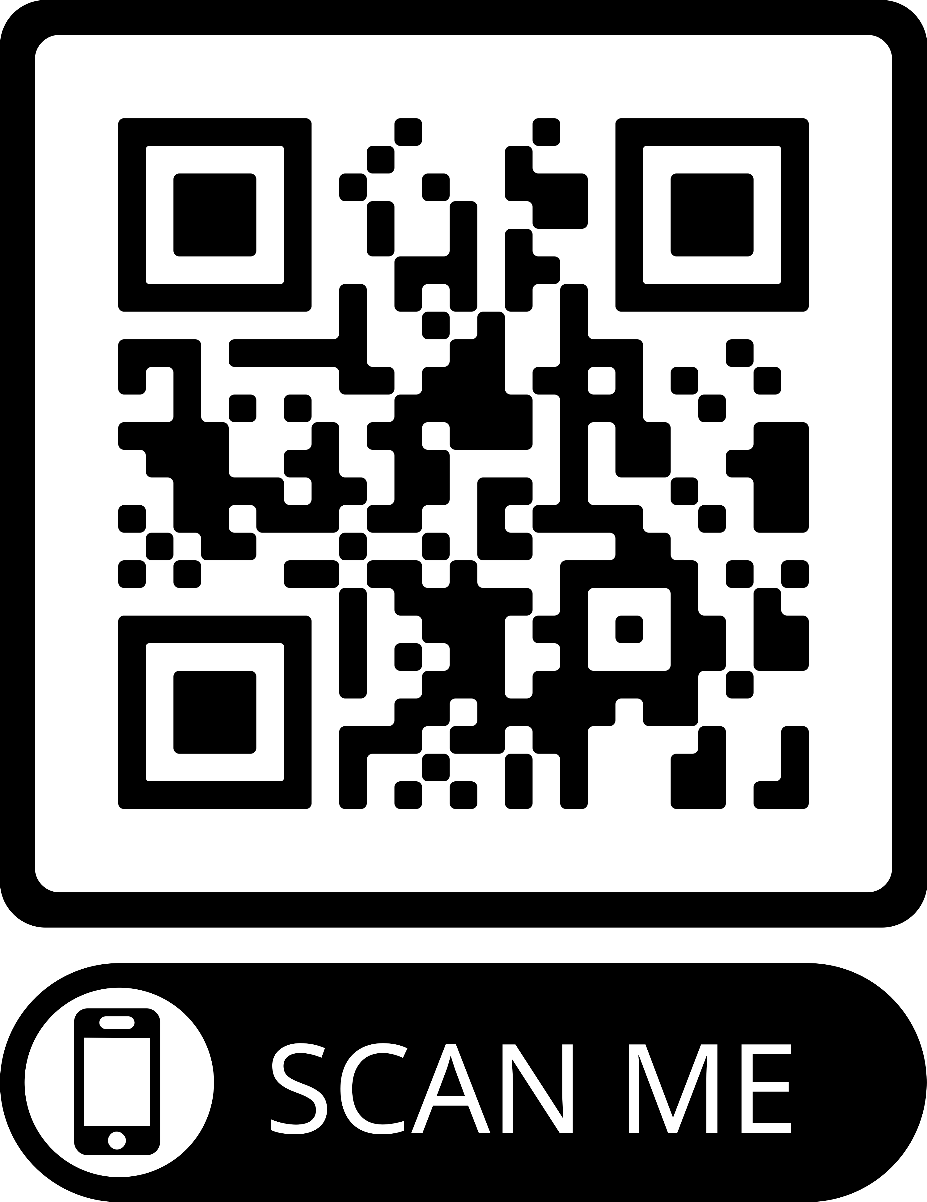
Thank You!
Please use the QR Code or use the link in the chat to access the feedback form this training!
Notes:
https://forms.office.com/r/M3QMr944eS

